Slide 1

Module 8: Overview of Shared Memory and Distributed Memory Architecture
Prof. M.NIVEDITA, SCOPE,VIT Chennai.

Slide 2
Single core
Single core processor has only one core and it can process only one operation at a time.
Problems:
The clock time has to be increased to execute the tasks faster in the processor.
The increase in clock time drastically increases the heat dissipation and power consumption to high levels which degrades the processor performance.

Slide 3
Multicore Architectures
Two or more independent processors are combined into a single integrated circuit.
Thus the processing power is increased while keeping clock speeds at an efficient level.
A processor with 2 cores can process the instructions with similar speed when compared to a single core processor running at twice the clock speed, yet the energy consumption by the dual core processor would still be less.
Multi-core processors comes under MIMD Category.

Slide 4
Memory and Communication
Main memory in the parallel architectures is of two types
Shared Memory
Distributed Memory

Slide 5
Shared Memory Architecture
General Characteristics:
The same memory resources will be shared by multiple processors but they can operate independently.
Changes made by one processor in a memory location will be visible to all the other processors.
It can be classified as two main classes such as
UMA and
NUMA.

Slide 6
Uniform Memory Access(UMA):
Known as Symmetric Multiprocessor (SMP)
The time taken by any processor to access any word in main memory is same (Uniform access times to memory)
Cache Coherent UMA(CC-UMA)- Changes made by one processor in a memory location will be known by all other processors. It will be accomplished at the hardware level.

Slide 7
Symmetric multiprocessor Architecture
CPU
CPU
CPU
CPU
Cache
Cache
Cache
Cache
BUS
Primary memory
I/O Devices

Slide 8
Non-Uniform Memory Access(NUMA)
Two or more SMPs will be physically linked.
The memory of one SMP can be directly accessed by another.
Access time to all memories will not be uniform for all processors.
Since all the processors access the memory through the link in general it will be slower.
Cache Coherent NUMA (CC-NUMA) is also there.

Slide 9
Distributed multiprocessors (NUMA)
CPU
CPU
CPU
Cache
Cache
Cache
Memory
I/O Devices
Memory
I/O Devices
Memory
I/O Devices
Interconnection Network
9

Slide 10
Advantages and Issues of Shared Memory
Advantages:
It is easy to program since all processors has single view of data.
Faster communication between the processors.
Issues:
Leads to contention since several processors try to access same memory location causing access time degradation.
Lack of coherency of data.

Slide 11
Advantages and Issues of Distributed Memory
Advantages:
Scalability – The memory size will increase proportionately with the increase in processor number.
Rapid access to its local memory without interference and overhead.
Issues:
The issue with distributed memory is how to distribute the data over the memories.
Data communication between processors has to be taken care by the programmer.

Slide 12
Cache Coherence in SMP
x
x
x
x
P1
P2
P3
Pn
Multiple copies of x
What if P1 updates x?
12

Slide 13
The Cache Coherence Problem
P
P
A = 7
3
A = 5
A = 5
Cache
Cache
1
2
A = 5
Memory
13

Slide 14
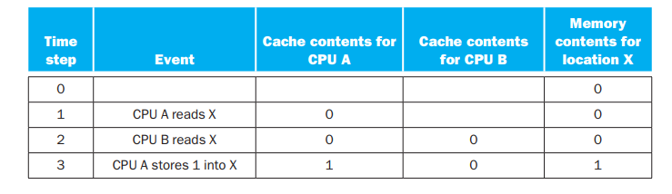
Cache Coherence Problem
Example : X- memory location, A&B - Processors
Assume write through protocol is being followed.
14

Slide 15
Cache Coherence Protocols
Cache coherence protocols are the one that maintain coherency among the processors.
These protocols track the state of any data block that is being shared among the processors.
Snooping - popular one among cache coherence protocols.
Snooping Protocols:
Bus activities will be monitored by the cache controller and the appropriate coherency commands will be carried out when necessary.
15

Slide 16
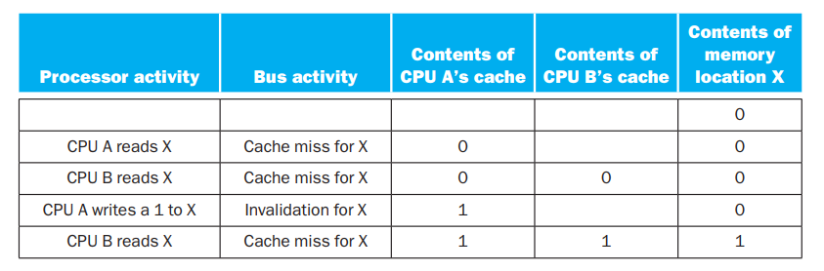
Write invalidate protocol
If a processor needs to write something to the data item it should have exclusive access to that item.
Exclusive access means when the write occurs, no other readable or writable copies of an item exist
If any other caches has that item it will be invalidated.
16

Slide 17
An Example Snooping Protocol
Invalidation-based
Each cache block is in one of three states
Shared:
Cache content has the clean data & according to the existing contents in memory
Any processor can read the data block.
Exclusive:
Only one cache has the correct value of the data block.
Write to the data can be done by that processor only.
Invalid:
block contains no valid data
17

Slide 18
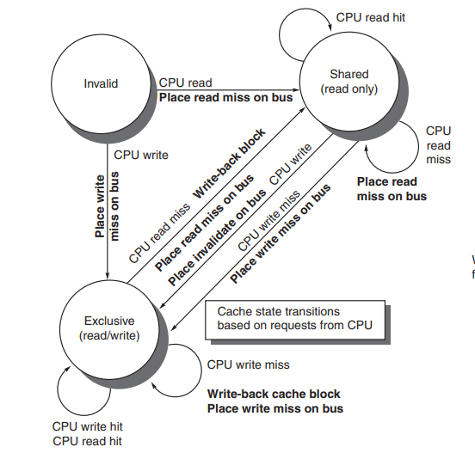
State transitions (CPU side)(Hennessey and Patterson Fig 5.6)
18

Slide 19
Reference Book
1.“Computer Organization and Design-The Hardware/Software Interface” by Hennessey and Patterson.

